Slide 1


Final review on Major Project
“Attribute Based Access Control using Blockchain”
Rajesh S M
By:
Sujith Reddy M 321910304034
Sathish Kumar H S 321910304035
Tejashwini. P 321910304048
Kartik Patil 321910304055
Damera Dinesh 321910304060
Under the Guidance of
Rajesh S M
Assistant Professor
Department of CSE
GITAM University Bengaluru

Slide 2
CONTENTS
Abstract
Introduction
Literature Survey
Problem Definition
Objectives
Solution Strategy
Methodology
Implementation
Project Structure Flow
Execution calls
Working Environment
Testing
Experimental Results
Code Walkthrough
Conclusion
References

Slide 3
Abstract :-
A large amount of data is being created every day on the internet. This includes our personal data. Access to this personal data should be regulated properly. Eg: Internet of Things (IoT) devices produce a lot of private data.
Traditional centralized access control systems lead to shortcomings of a single point of failure, low overall system efficiency, and ethical and privacy issues.
To overcome such challenges, an attribute-based access control model using blockchain.
ABAC grants access based on the attributes presented by the target.

Slide 4
Introduction :-
Access control is a security technique that regulates who or what can view or use resources in a computing environment. It is a fundamental concept in security that minimizes risk to the business or organization. Two types of access control - Physical and Logical access control.
Physical Access Control -> Campuses, Buildings, Rooms
Logical Access Control -> Types
Mandatory Access Control
Discretionary Access Control
Role Based Access Control
Attribute Based Access Control
Identity Based Access Control

Slide 5
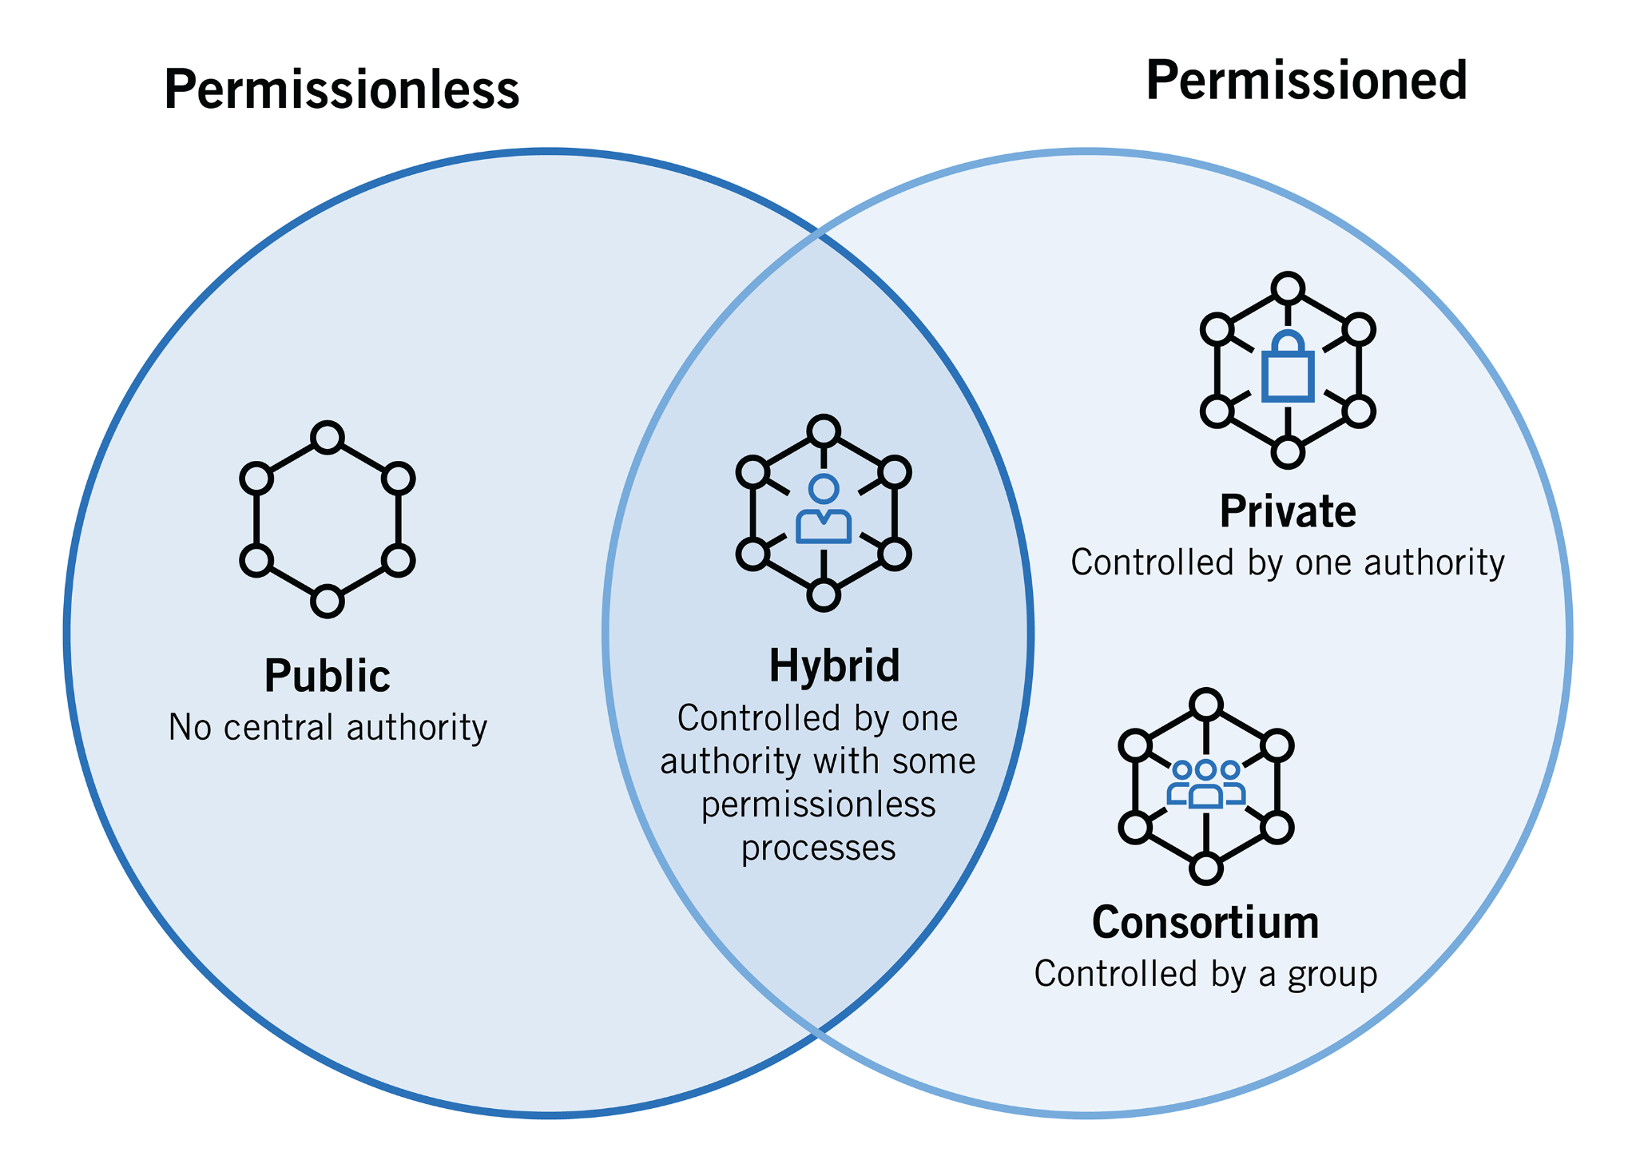
Blockchain is a list of records called blocks that store data publicly and in chronological order. The information is encrypted using cryptography to ensure that the privacy of the user is not compromised and data cannot be altered. Blockchain is immutable, decentralized, ensures integrity, shared, consistency.
Fig 1 [1]: Types of Blockchain
[1] https://www.foley.com/en/insights/publications/2021/08/types-of-blockchain-public-private-between

Slide 6
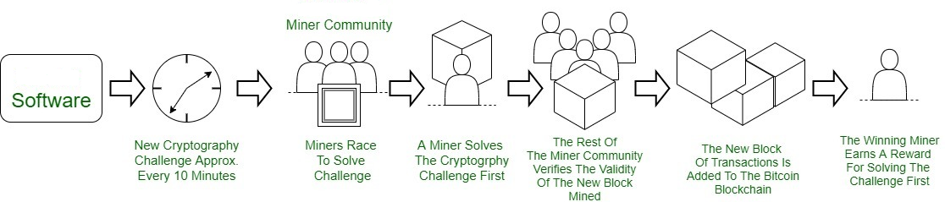
Miner plays a vital role in verifying and adding access control transactions to the blockchain which include:
Verification: Miners verify the validity of transactions.
Selection: Miners select valid transactions based on transaction fees.
Block creation: Miners create a block by bundling transactions and adding a header.
Proof of work: Miners perform a computationally intensive puzzle to add the block to the blockchain.
Broadcast: Miners broadcast the block to the network, and other nodes verify and add it to their copy of the blockchain.
Fig 2 [2]: Mining in Blockchain
[2] https://media.geeksforgeeks.org/wp-content/uploads/20200402132440/Untitled-Diagram66-3.jpg

Slide 7
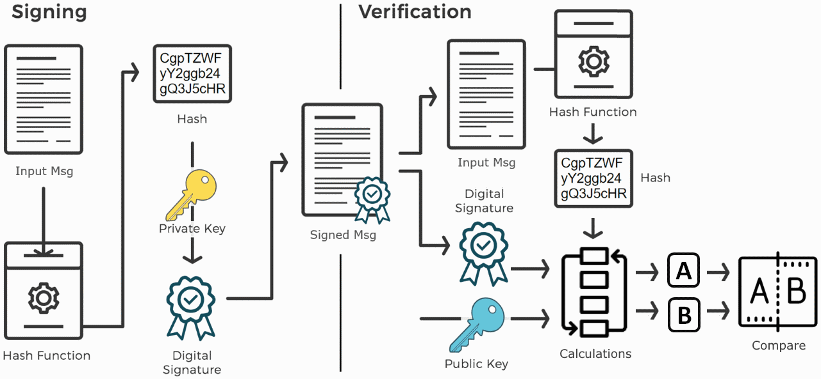
Digital Signature:-
Fig 3[3]: Digital Signature
[3] https://cryptobook.nakov.com/digital-signatures

Slide 8
Digital Signature in ABAC on blockchain ensures the integrity and authenticity of user requests and policy enforcement, providing accountability and auditability. The process of using digital signatures in attribute-based access control (ABAC) using blockchain is as fallows:
Policy issuer creates ABAC policy and signs it with their private key.Blockchain verifies user's signature and checks for necessary attributes.
If verification is successful, user is granted access and it's recorded on the blockchain for audit purposes.If verification fails, user is denied access and the attempt is recorded on the blockchain for audit purposes.
Digital signatures ensure integrity of ABAC policies on blockchain.
Digital signatures authenticate users and verify access permissions.
Digital signatures enforce accountability and prevent denial of involvement.
Digital signatures ensure non-repudiation for auditability.
Digital signatures protect privacy and confidentiality of user attributes.

Slide 9
Kotlin is a new open-source programming language like Java, JavaScript, Python etc. It is a high level strongly statically typed language that combines functional and technical part in a same place.
Easy Language
Very Concise
Runtime and Performance
Interoperability
Brand New
JSON (JavaScript Object Notation) is an open standard file format and data interchange format that uses human-readable text to store and transmit data objects consisting of attribute–value pairs and arrays (or other serializable values). It is a common data format with diverse uses in electronic data interchange, including that of web applications with servers.

Slide 10
Literature Survey :-
Authors Name, Journal Name, Vol., Year, Page, Title of the Paper | Inference | Research Gap | Relevance with the present work
W. Liang, M. Tang, J. Long, X. Peng, J. Xu, and K.-C. Li, ‘‘A secure fabric blockchain-based data transmission technique for industrial Internet-of-Things,’’ IEEE Trans. Ind. Inf., vol. 15, no. 6, pp. 3582–3592, Jun. 2019 A Secure Fabric Blockchain-Based Data Transmission Technique for Industrial Internet-of-Things | Proposed a secure Fabric-based data transmission technique which solved the problems of low security, high management cost, and difficulty in supervision. | Little or no evidence to address the research problem of have low security, high management cost of the trading center, and big difficulty in supervision | Proposes a secure Fabric blockchain-based data transmission technique for industrial IoT. This technique uses the blockchain mechanism.
[4] Table 1 : Literature Survey

Slide 11
Authors Name, Journal Name, Vol., Year, Page, Title of the Paper | Inference | Research Gap | Relevance with the present work
O. Novo, ‘‘Blockchain meets IoT: An architecture for scalable access management in IoT,’’ IEEE Internet Things J., vol. 5, no. 2, pp. 1184–1195, Apr. 2018. Blockchain Meets IoT: An Architecture for Scalable Access Management in IoT | A centralized access control scheme for the IoT devices was proposed. The scheme used a single smart contract to reduce the communication cost between nodes. It has six advantages, which are Mobility, Accessibility, Concurrency, Lightweight, Scalability and Transparency | As access management technologies exist in IoT, they are based on centralized models which introduce a new variety of technical limitations to manage them globally. | Proposed a new architecture for arbitrating roles and permissions in IoT. The new architecture is a fully distributed access control system for IoT based on blockchain technology.
[5] Table 2 : Literature Survey

Slide 12
Authors Name, Journal Name, Vol., Year, Page, Title of the Paper | Inference | Research Gap | Relevance with the present work
Y. Zhang, S. Kasahara, Y. Shen, X. Jiang, and J. Wan, ‘‘Smart contract based access control for the Internet of Things,’’ IEEE Internet Things J., vol. 6, no. 2, pp. 1594–1605, Apr. 2019. Smart Contract-Based Access Control for the Internet of Things. | ACC implemented policy-based authorization by checking the behavior of objects. JC was used to judge the wrong behavior and return the corresponding punishment. RC was used to register the above two smart contracts and provide update, delete, and other operations. | The Practices deviate from research findings.Changing smart contract processes is almost impossible, any error in the code can be time-consuming and expensive to correct.Also, the acc is not the efficient access control mechanism. | Integrating a smart contract-based framework, which consists of multiple access control contracts (ACCs), one judge contract (JC), and one register contract (RC), to achieve distributed and trustworthy access control for IoT systems.
[6] Table 3 : Literature Survey

Slide 13
Authors Name, Journal Name, Vol., Year, Page, Title of the Paper | Inference | Research Gap | Relevance with the present work
G. Papadodimas, G. Palaiokrassas, A. Litke, and T. Varvarigou, ‘‘Implementation of smart contracts for blockchain based IoT applications,’’ in Proc. 9th Int. Conf. Netw. Future (NOF), Nov. 2018, pp. 60–67. Implementation of smart contracts for blockchain based IoT applications | A distributed application (DAPP) based on Ethereum was proposed. It combines the SaaS business model with blockchain, which was used to buy and sell sensor data. | A distinction in research methods is needed to have new insights or to avoid ambiguous findings for these Sensing-as-a-Service (S2aaS) business models combined with blockchain. | A decentralized application (DApp) based on blockchain technology for sharing Internet of Things (IoT) sensors’ data, and demonstrating various challenges addressed during the development process. This application combines blockchain technology with IoT and operates through smart contracts that are executed on the Ethereum blockchain.
[7] Table 4 : Literature Survey

Slide 14
Problem Definition :-
With the distributed deployment of devices and their large number and scale, the access control of device resources is facing significant challenges.
The access control technology is an essential means to protect resources, widely used in various systems and environments.The centralized designs have disadvantages.
Attributed-based access control (ABAC) is a logical access control model, which controls the access between subjects and objects, according to the attributes of entries, operations and related environments.

Slide 15
Objectives :-
Using blockchain, we implement ABAC logical access control.
Blockchain technology offers features similar to decentralization, high confidence, and tamper-resistance, which are advantages to working resource consumption, scalability and trust issues – all of which are challenges for access control by traditional mechanisms.

Slide 16
Solution Strategy :-
We propose a blockchain-based access control system and describe its workflow and architecture in detail. The system uses distributed architecture to separate users and devices, and implemented the dynamic management of permissions to support efficient access.
We implement the ABAC model, ABAC-Policy which contains Attribute of Subject, Attribute of Object, Attribute Environment, and Attribute Permission.

Slide 17
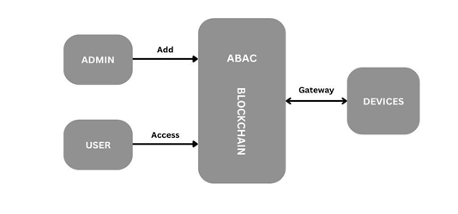
Methodology
Fig 4: ABAC Integrated With Blockchain

Slide 18
Implementation :-
We are trying to implement 2 algorithms which are as follows:
checkPolicy()
addPolicy()

Slide 19
Implementation :-
P = { AS, AO, AP, AE }
AS = { userId, role, group }
AO = { deviceId}
AP = { 1, allow
0, deny }
AE = { createTime, endTime}
P - Policy
AS - Attribute Of Subject
AO - Attribute Of Object
AP - Attribute Of Permission
AE - Attribute Of Environment

Slide 20
Implementation :-
if val(AP) != 1 or val(AP) != 0
isOK = False
end if
for item in AE do:
if item != < createTime, endTime > then
isOK = False
end if
end for
return isOK
checkPolicy() : boolean
input -> ABACP
isOK = True
for item in AS do:
if item != < userId,role, group > then
isOK = False
end if
end for
if AO.deviceID != <deviceId> then
isOK = False
end if

Slide 21
Implementation :-
addPolicy(): Null | Error
Input -> ABACP
if CheckPolicy(ABACP) == False
return Error("Bad Policy")
end if
Id <- SHA256(ABACP.AS + ABACP.AO)
err <- addABACP(Id, ABACP)
if err != null then
return Error(err.Text)
end if
return Null

Slide 22
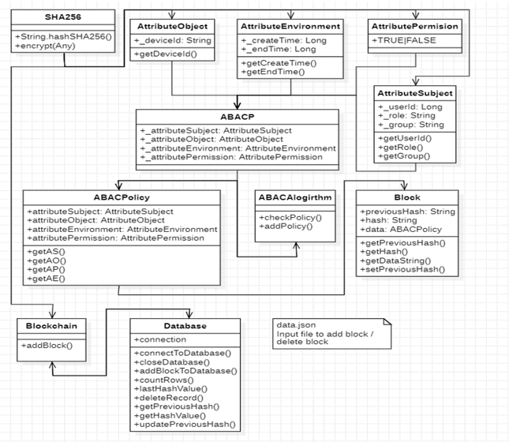
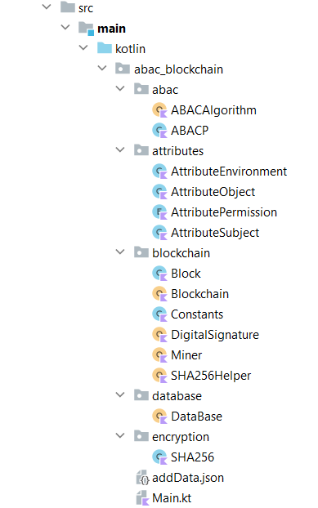
Project Flow Structure:-
Fig 5: Project Structure
Fig 6: Class diagram ABAC with Blockchain

Slide 23


Working Environment
IntelliJ IDEA
IntelliJ IDEA provides a set of inspections that are built-in static code analysis tools. They help you find potential bugs, locate dead code, detect performance issues, and improve the overall code structure
PostgreSQL
PostgreSQL is a powerful, open source object-relational database system that uses and extends the SQL language combined with many features that safely store and scale the most complicated data workloads.
Fig 7,8[8][9]: IntelliJ IDEA and PostgreSQL Icon
[8] https://en.wikipedia.org/wiki/PostgreSQL [9] https://en.wikipedia.org/wiki/IntelliJ_IDEA

Slide 24
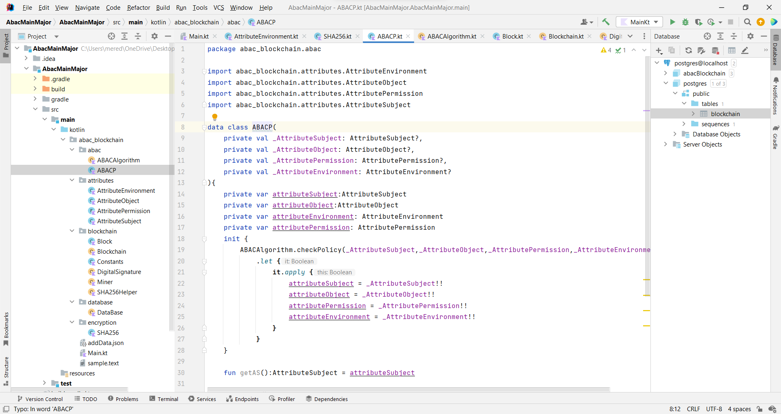
Working Environment Snapshots
Fig 9: Working environment snapshots

Slide 25
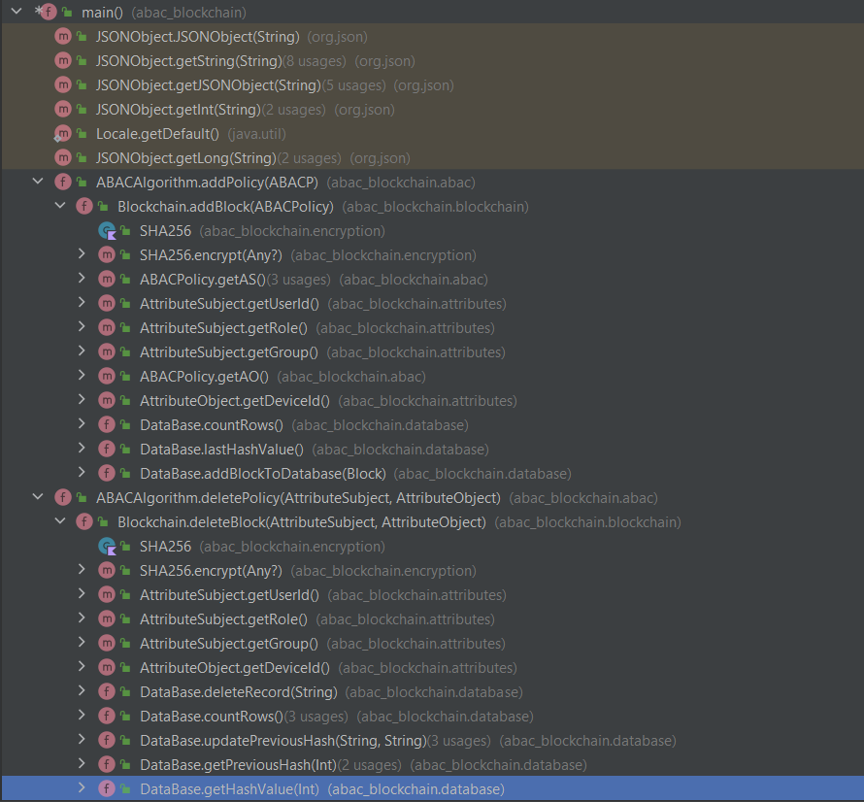
Execution calls:-
Fig 10: Execution calls

Slide 26
Testing:-
Input | Description | Result
{"blockId": 5080, "transaction": "transaction 2370", "action": "add", "attributeSubject":{"userId" : 58003, "role": "sensor", "group": "detection"}, "attributeObject": {"deviceId":"AX0002"}, "attributePermission": "true", "attributeEnvironment": {"createTime": 1000, "endTime": 10000}} | Data provided to add block action is accurate | Successful
Table 5 :Test case table

Slide 27
Testing:-
Input | Description | Result
{"action": "add", "attributeSubject":{"userId" : 58102,"group": "detection"}, "attributeObject": {"deviceId":"AX0101"}, "attributeEnvironment": {"createTime": 1000, "endTime": 10000}} | Data provided to add block action is not accurate, here missing of data or inaccurate data is given | Unsuccessful
Table 6 :Test case table

Slide 28
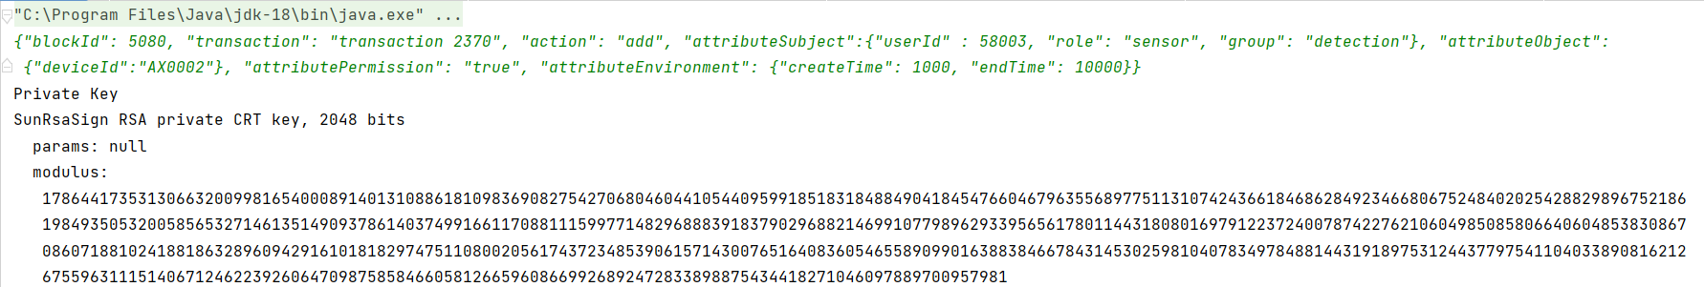
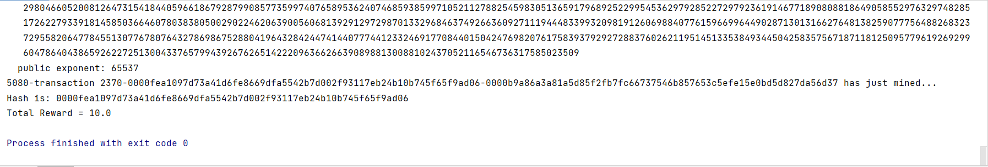
Experimental Results:-
Fig 11: input add block data in JSON Format

Slide 29
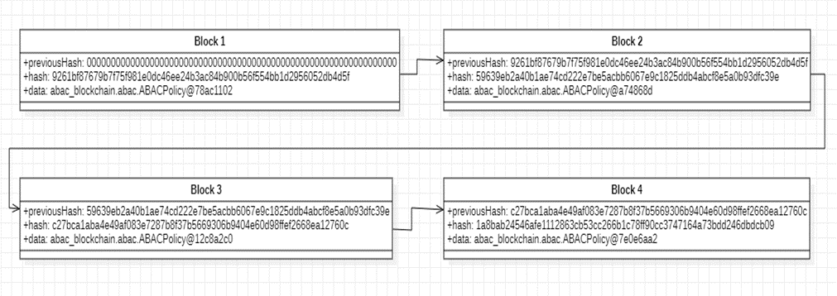
Experimental Results:-
Fig 12 : Blocks in blockchain

Slide 30
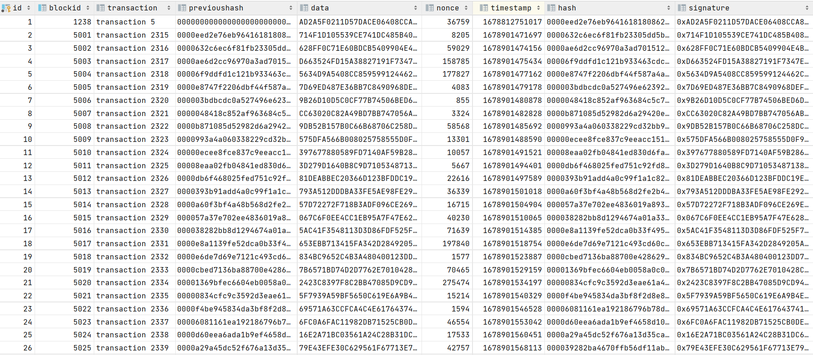
Experimental Results:-
Fig 13 : Block data in database

Slide 31
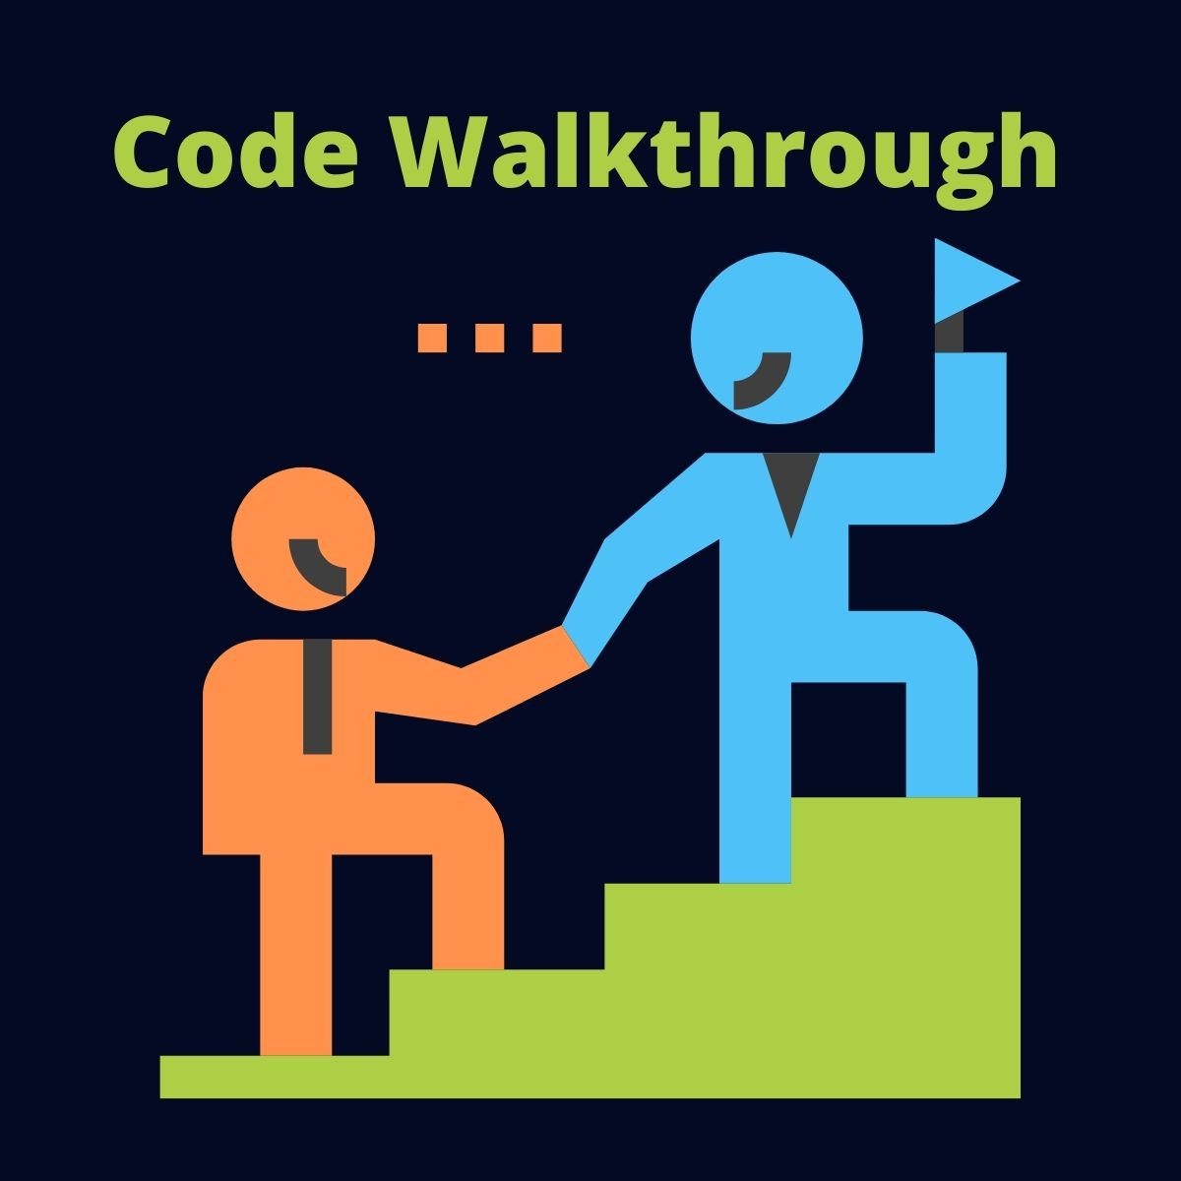
Code Walkthrough:-

Slide 32
Conclusion
This work proposed a Blockchain Attribute Based Access Control model (ABAC) that employs the blockchain as the trusted center of the access control model and implements the access control policy.
The data stored on the blockchain is trustworthy and credible because of its tamper-proof and no single point of failure features.
The proposed model is fully decentralized (no third-party required), user-friendly, user-transparent, fault-tolerant, scalable, and compatible with a wide range of access control models.

Slide 33
References
[1] https://www.foley.com/en/insights/publications/2021/08/types-of-blockchain-public-private-between
[2] https://media.geeksforgeeks.org/wp-content/uploads/20200402132440/Untitled-Diagram66-3.jpg
[3] https://cryptobook.nakov.com/digital-signatures
[4] W. Liang, M. Tang, J. Long, X. Peng, J. Xu, and K.-C. Li, ‘‘A secure fabric blockchain-based data transmission technique for industrial Internet-of-Things,’’ IEEE Trans. Ind. Inf., vol. 15, no. 6, pp. 3582–3592, Jun. 2019
[5] O. Novo, ‘‘Blockchain meets IoT: An architecture for scalable access management in IoT,’’ IEEE Internet Things J., vol. 5, no. 2, pp. 1184–1195, Apr. 2018.
[6] Y. Zhang, S. Kasahara, Y. Shen, X. Jiang, and J. Wan, ‘‘Smart contract based access control for the Internet of Things,’’ IEEE Internet Things J., vol. 6, no. 2, pp. 1594–1605, Apr. 2019.
[7] G. Papadodimas, G. Palaiokrasas, A. Litke, and T. Varvarigou, ‘‘Implementation of smart contracts for blockchain based IoT applications,’’ in Proc. 9th Int. Conf. Netw. Future (NOF), Nov. 2018, pp. 60–67.
[8] https://en.wikipedia.org/wiki/PostgreSQL
[9] https://en.wikipedia.org/wiki/IntelliJ_IDEA

Slide 34
THANK YOU

